Slide 1
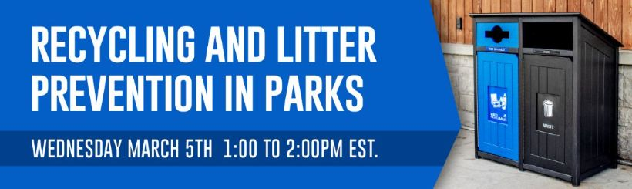

Slide 2


Today’s Panelists
Meredith Gauthier
Sustainability & Resilience Program Manager
City of Austin, Parks & Recreation Department
Taylor Emerson
Manager of Strategic Planning
San Francisco Recreation & Parks Department

Slide 3



Join the Discussion
From your toolbar:
Share your experience & opinions
Look for links to resources
Type direct questions for panelists

Slide 4
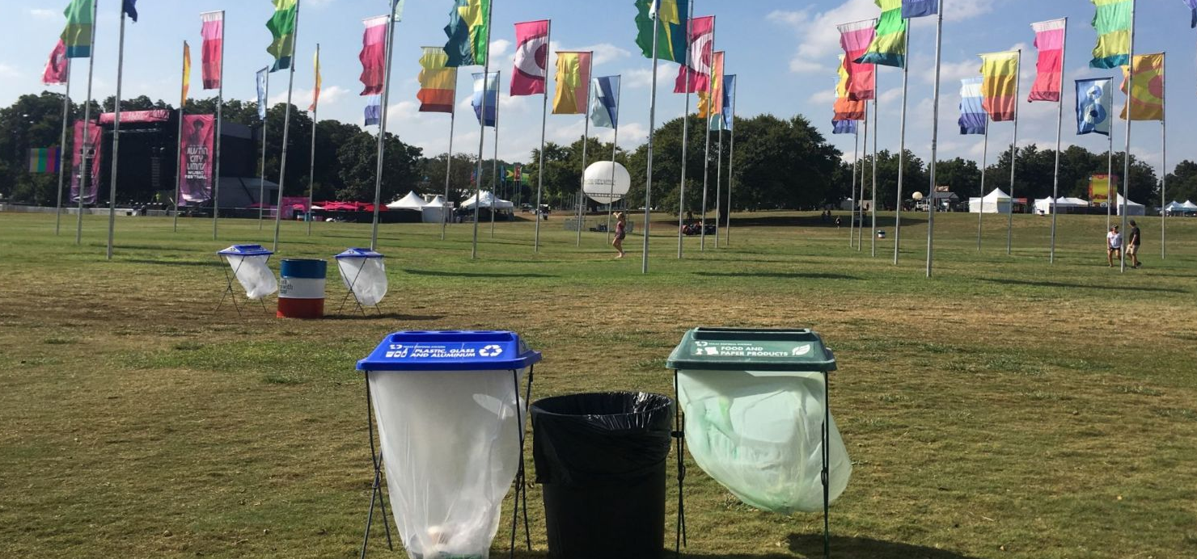
Recycling Implementation in Public Parks
Meredith Gauthier
LEED AP BD+C, SITES AP, TRUE Advisor
Sustainability & Resilience Program Manager
City of Austin Parks and Recreation

Slide 5
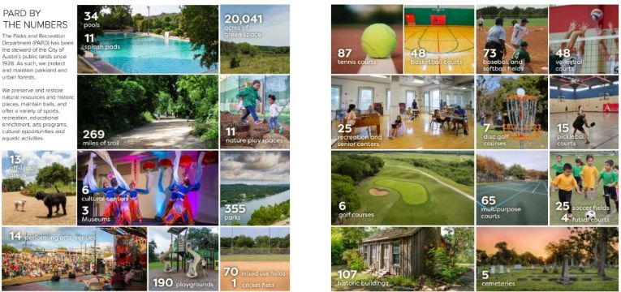
Notes:
355 parks, nearly 300 of those parks have some level of trash and recycling receptacles.

Slide 6
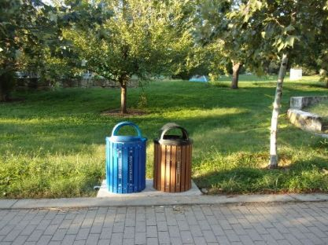

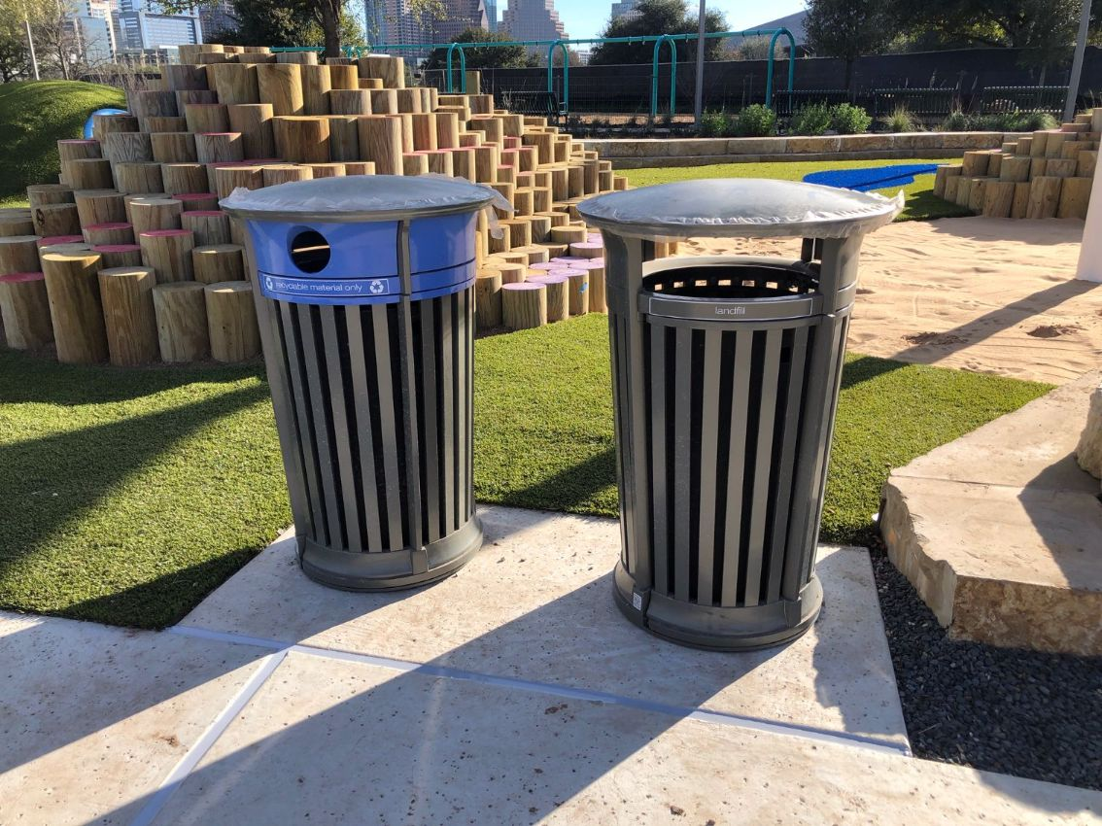
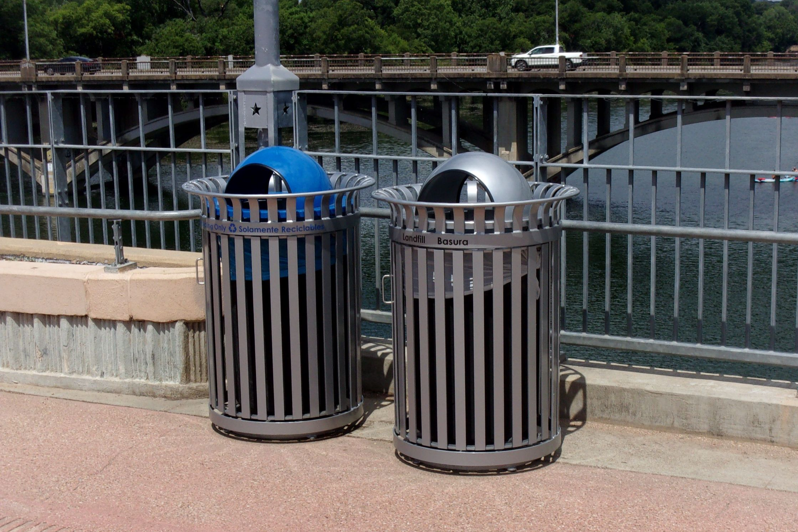
PARKS & RECREATION ZERO WASTE INITIATIVES
MEREDITH GAUTHIER, SUSTAINABILITY & RESILIENCE PROGRAM MANAGER
Department-Wide Zero Waste Initiatives
  Ensure compliance with Universal Recycling Ordinance guidelines and support City of Austin Zero Waste goals and standards
  Develop and implement recycling and organics diversion guidelines for PARD facilities and events
  PARD Materials Reuse Group
  Coordinate with volunteer groups for litter abatement workdays
Recycling Plan Implementation
  Phase I: Metro parks, Athletics sites, Aquatics sites, Golf sites, CIP projects
  Phase II: District parks
  Phase III: Neighborhood parks, greenbelts and
  trailheads, and special use sites
Add Picture
Zero Waste Initiatives Recycling Plan Implementation

Slide 7
Austin Sustainability Goals
Reduce the amount of material
sent to landfills by 90% by 2040.
Zero Waste by 2040
Mitigate the impacts of climate change as part of Austin’s Climate Equity Plan and reduce fossil fuel use to nearly zero by 2040.
Net-Zero Emissions by 2040
Notes:
As you know, the City has several sustainability goals.
Austin is working to achieve zero waste by 2040. This means reducing the amount of material we send to local landfills by 90% by the year 2040.
Austin Resource Recovery’s 2023 Comprehensive Plan outlines milestones to guide the department’s actions towards that goal.
Improving our waste diversion at City Facilities is part of that goal.
Another ambitious objective is the Austin Climate Equity Plan which aims to equitably reach net-zero community-wide greenhouse gas emissions by 2040.
This plan, created by the Office of Sustainability, acknowledges that climate change affects everyone, but that the impacts are not felt equally among communities and Austin is committed to reducing greenhouse gas emissions to preserve a livable climate for all.

Slide 8
What is Zero Waste?
Reduce
Repair
Compost, Recycle
Recover
Avoid, Redesign, Rethink
Reuse
Minimizing waste production as much as possible
Reducing consumption
Prioritizing reusing, repairing, composting, and recycling over landfilling
Disposal is the
very last step
Notes:
As you know, the City has several sustainability goals.
Austin is working to achieve zero waste by 2040. This means reducing the amount of material we send to local landfills by 90% by the year 2040.
Austin Resource Recovery’s 2023 Comprehensive Plan outlines milestones to guide the department’s actions towards that goal.
Improving our waste diversion at City Facilities is part of that goal.
Another ambitious objective is the Austin Climate Equity Plan which aims to equitably reach net-zero community-wide greenhouse gas emissions by 2040.
This plan, created by the Office of Sustainability, acknowledges that climate change affects everyone, but that the impacts are not felt equally among communities and Austin is committed to reducing greenhouse gas emissions to preserve a livable climate for all.

Slide 9
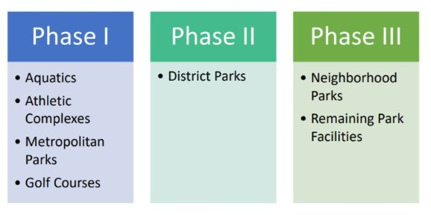
Phased Approach to Recycling Implementation in 300 Parks
Started in late 2019, recycling implementation completed early 2024.
What’s next? MAINTENANCE PHASE

Slide 10
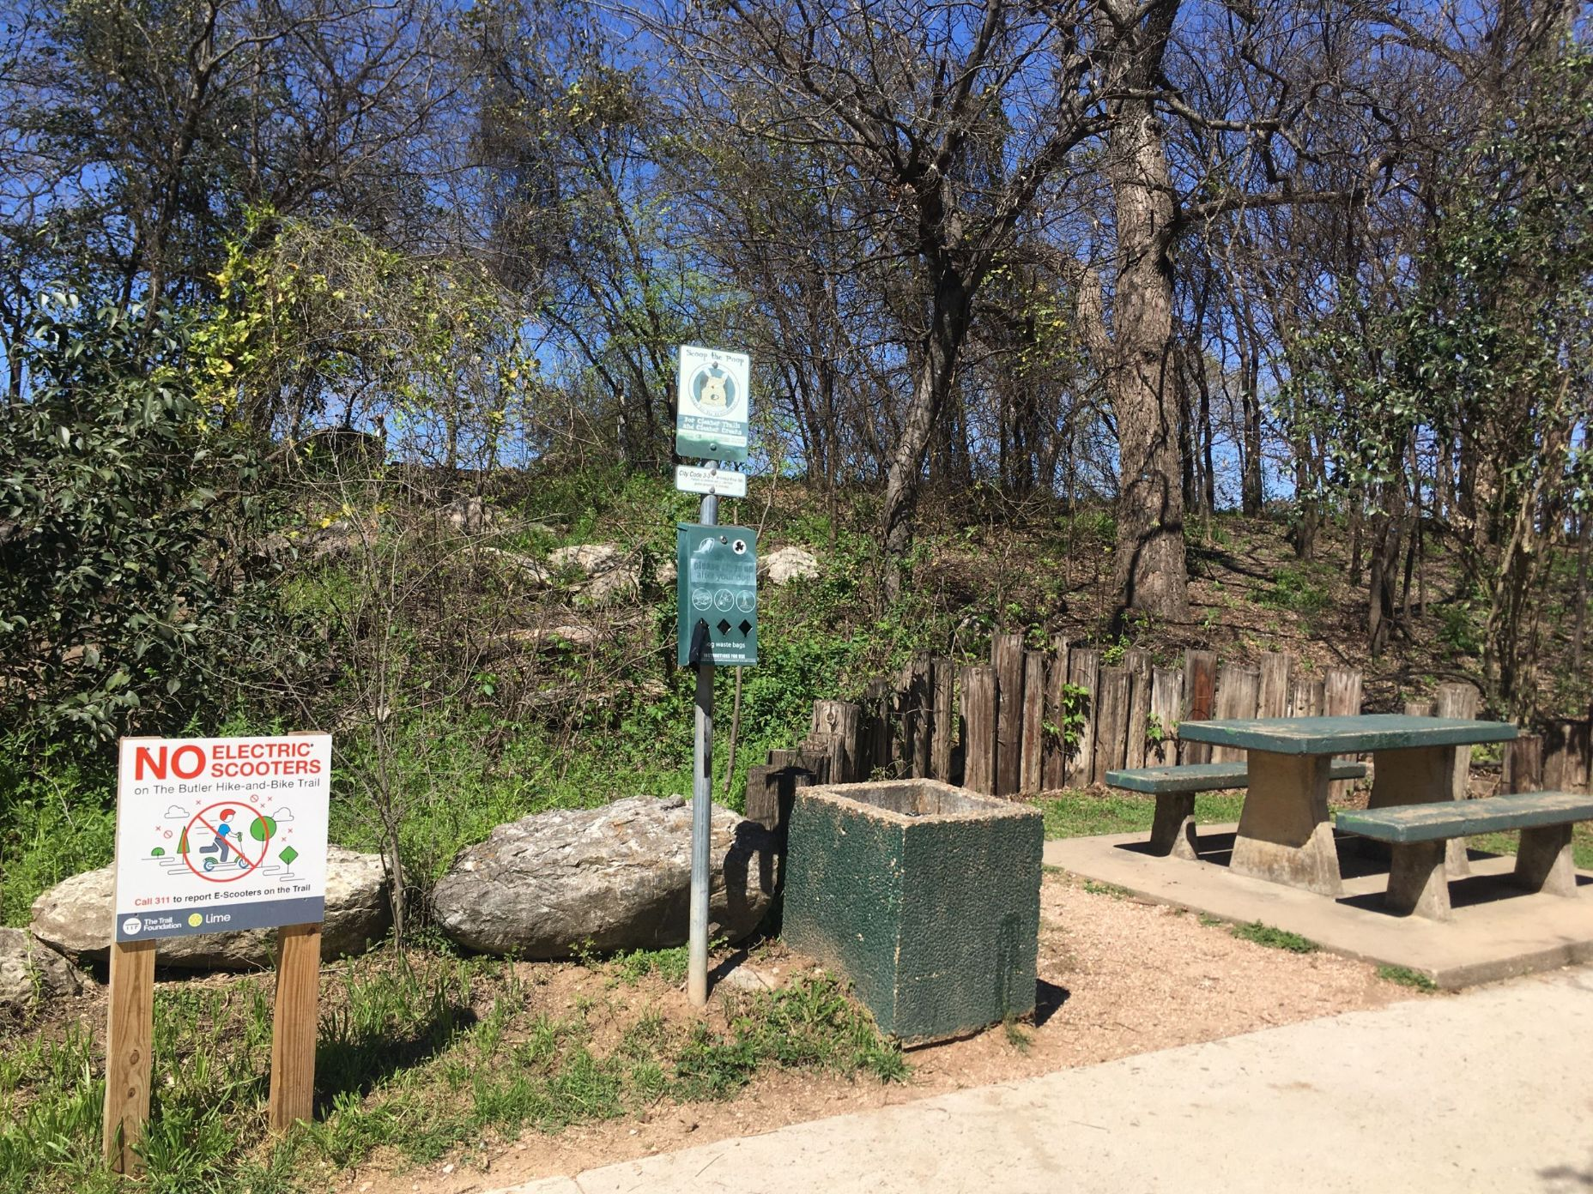
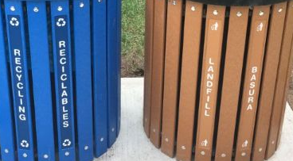
Updated Receptacles
Removed outdated concrete receptacles
Added new color-coded, paired receptacles with English & Spanish labels as well as Mutt Mitt Stations for dog waste
Recycling on left, trash on right – placement doesn’t matter as much as consistency throughout park system

Slide 11
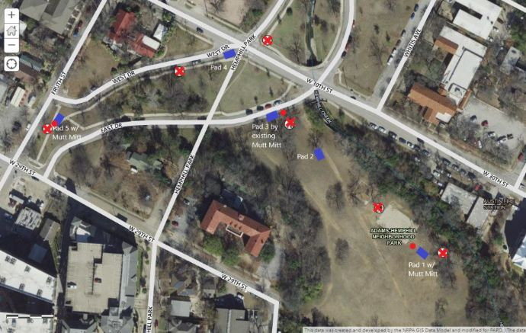
Receptacle Installation Plans for Each Park
Deliberate, systematic approach throughout the park system
Identified locations with maintenance staff -> CRITICAL to partner with your O&M team to understand daily usage & seasonal patterns
Optimized dumpster routes
Pocket Parks (smallest parks) transitioned to Pack It In, Pack It Out unless park has additional amenities (picnic shelters, playground, etc.)

Slide 12
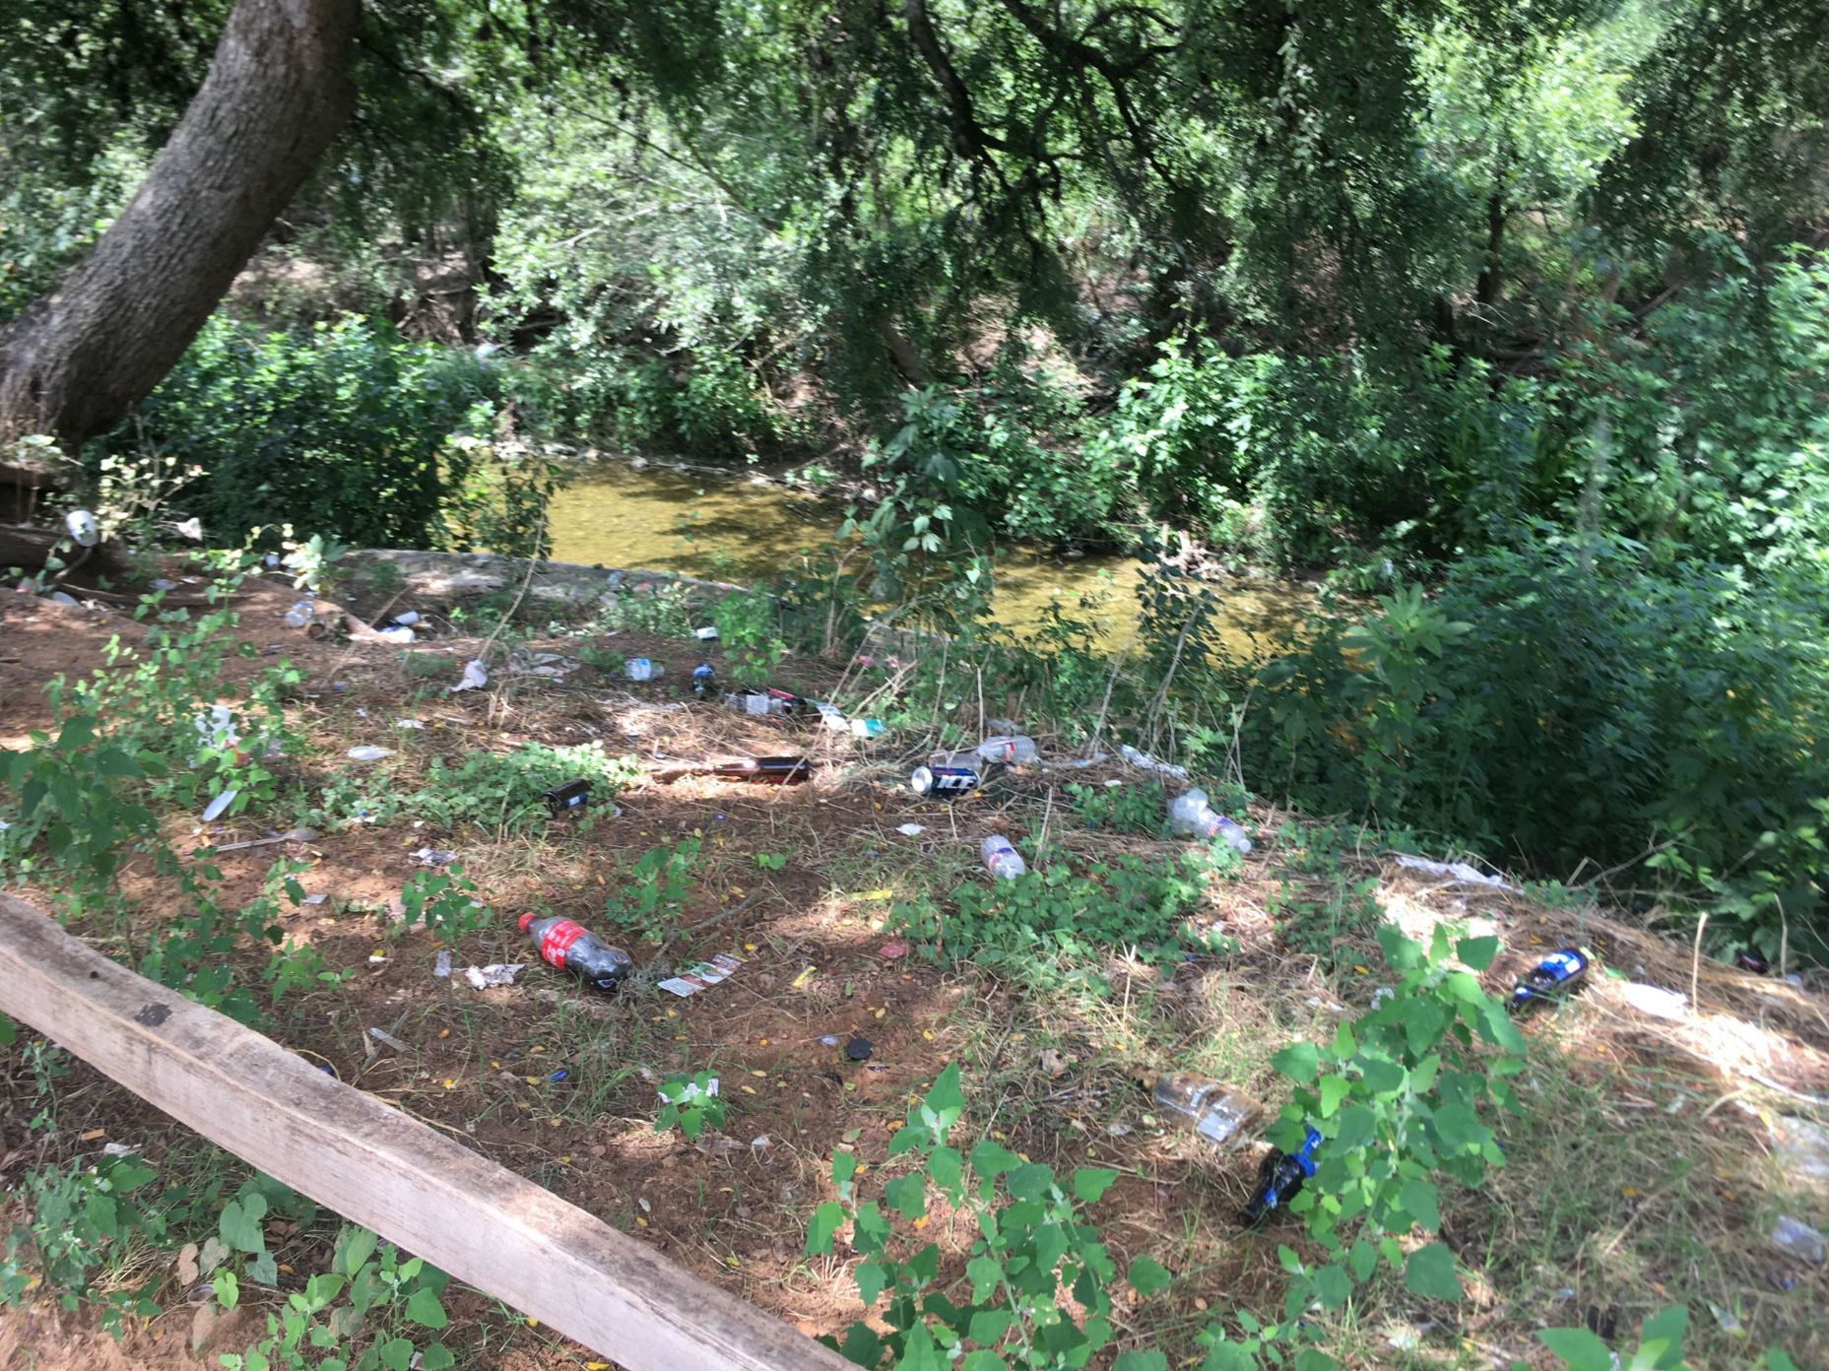
Let’s Talk Litter…

Slide 13
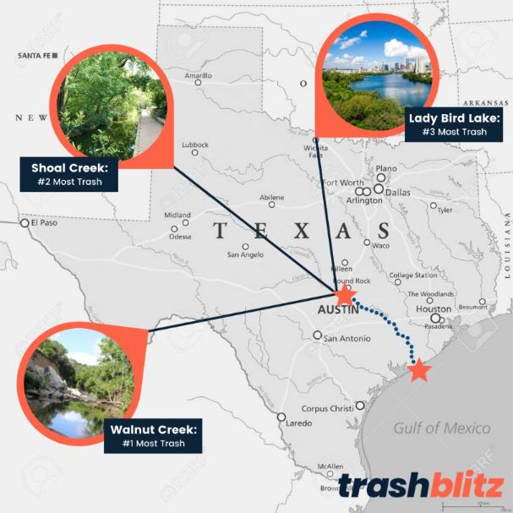

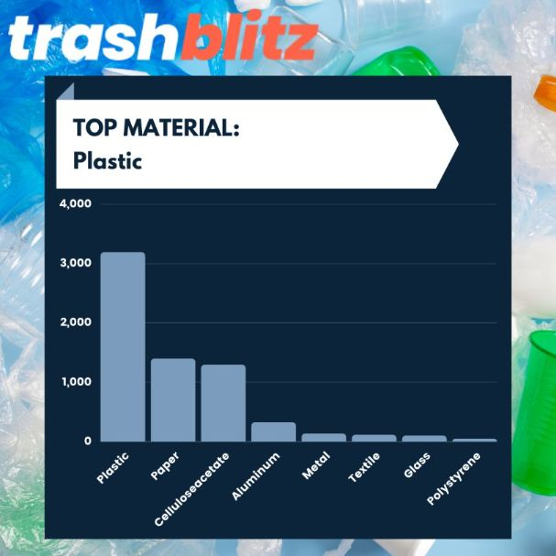
2021 TrashBlitz Austin Litter Study
How bad was our litter problem?
Spring 2021 TrashBlitz Austin study
    Community-based initiative w/ network of NGOs, volunteers, and local projects to collect litter-related data.
    Partners: The 5 Gyres Institute, Litterati, Inland Ocean Coalition, Into the Sea
168 volunteers + 80 randomly selected sampling points across Austin -> 6,656 total pieces of litter observed and collected
30% of plastic litter observed was at these 3 watershed locations. →
Cigarette butts (32%), wrappers (22%), and bottle caps (7%) were the top littered objects by number of items (count).
Litter analysis showed 68% of observed litter was made of plastic.
Single-use items were ~1/3 of all observed litter.
Top 3 littered brands by number of items were Coca-Cola, Marlboro, and McDonalds.
Glass and aluminum accounted for over 75% of the total weight of litter.

Slide 14
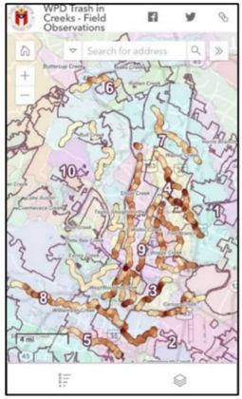
2022 Watershed Study
How bad was our litter problem?
Watershed Protection Department study in response to City Council Resolution
20 Creeks, 110 miles, Observations every 30ft -> 19,467 data points
76% of the trash is found in about 10% of the creek area
NO correlation with any one feature like zoning/land use, density, parks
Top three sources for the trash are homeless encampments, overflowing dumpsters and dumping in general
HOW TO FIX THIS?
1) EXTRACTION (physically removing trash from waterways)
ex: structural controls, machines, manual labor
2) INTERCEPTION (keeping trash from entering waterways)
ex: education, enforcement, landscape cleanups, structural controls
3) SOURCE REDUCTION (stemming the flow into our community)
ex: limit single use plastics

Slide 15
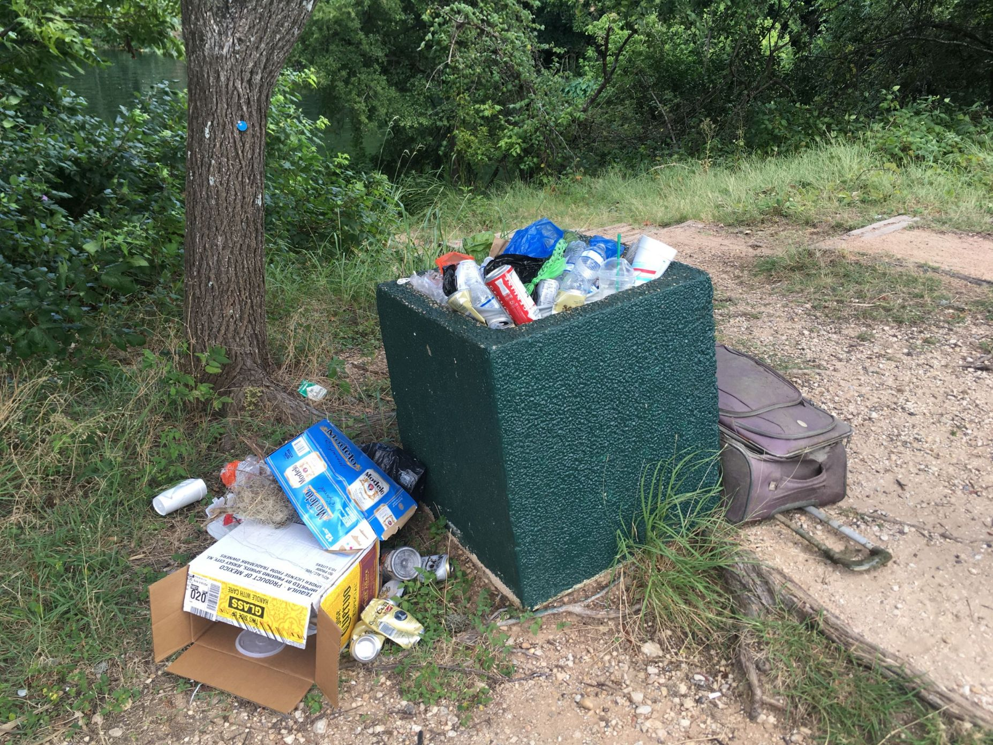
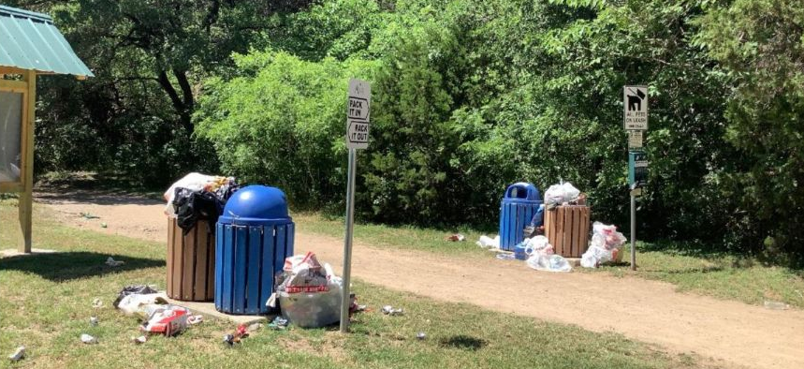
Where is litter coming from?
Piling trash next to receptacles
  Solution: more receptacles, increased servicing
  Pack It In, Pack It Out signage (note: not followed here!)

Slide 16
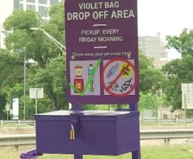

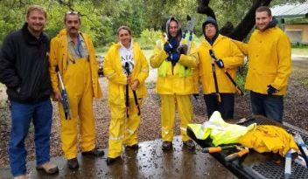

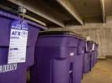
Where is litter coming from?
Homeless encampments at parks
  Solution: difficult issue, multi-pronged approach needed to assist those experiencing homelessness and help reduce litter from encampments
  Partner with The Other Ones Foundation for park cleanups (alternative work program pays $15/hr and offers case management)
  Violet Storage Cart program for personal belongings
  and Violet Bags for trash with dropoff location
Photo source: The Other Ones Foundation

Slide 17
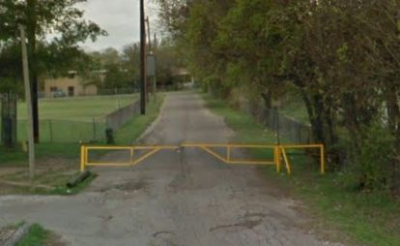
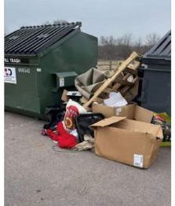

Where is litter coming from?
Illegal dumping
  Solution: wildlife/game cameras to photograph license plates
  Solution: locked dumpsters behind vehicle bollards/vehicle gates – prevent vehicles driving up to dump

Slide 18
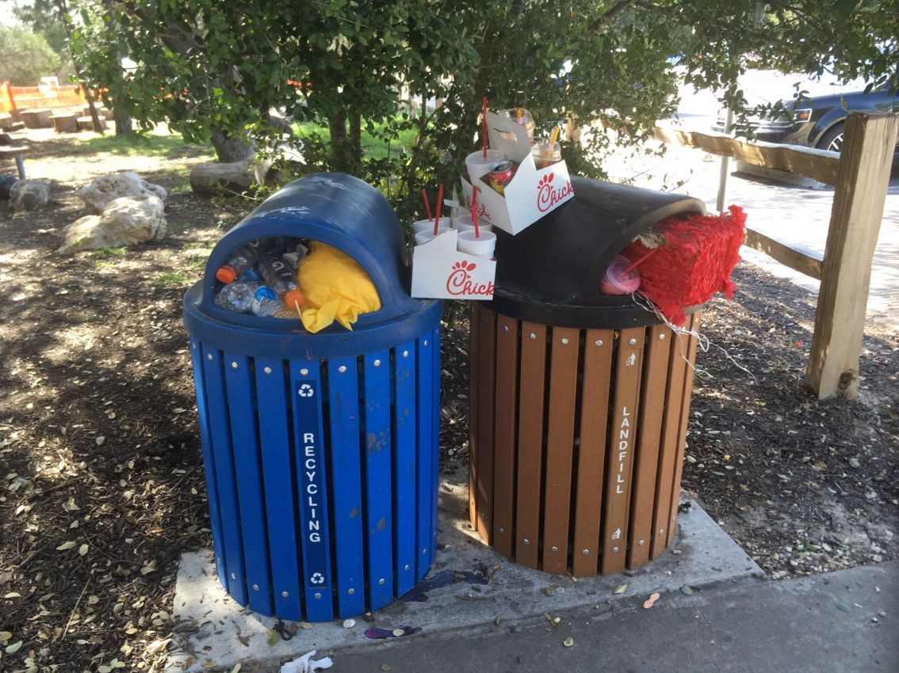
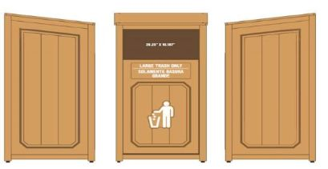
Where is litter coming from?
Piñata/cake box/pizza box problem… -->solution: oversized trash units added!

Slide 19
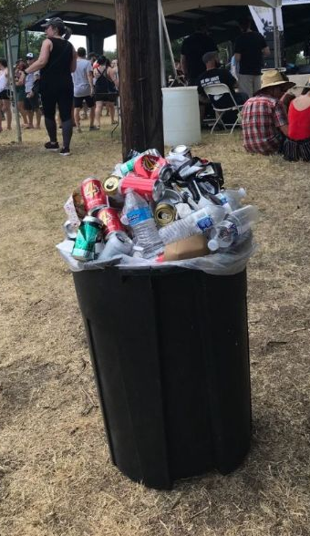
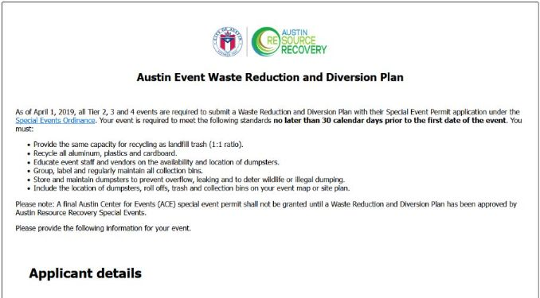
Where is litter coming from?
Third party events on parkland not planning for recycling
  Solution: Zero Waste plans required for events on parkland

Slide 20


City Plastic Commitments
GOAL: Reduce & EliminateSingle-use Plastics
Address problematic plastic waste by creating a circular economy for plastics, as part of a national and global commitment through the U.S Plastics Pact and New Plastics Economy Global Commitment.
Notes:
Another important and often unknown commitment:
The City of Austin is also committed to reducing and eliminating single-use plastics.
In 2018 and in 2020 the City signed commitments with two organizations: the Ellen MacArthur Foundation’s New Plastics Economy Global Commitment and the U.S. Plastics Pact. We are working together with businesses, non-profits, governments, and research institutions to create a more circular economy for plastics.

Slide 21


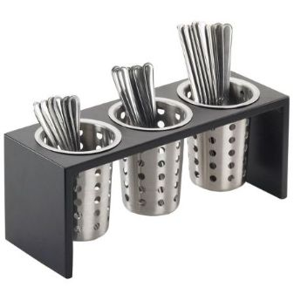
2024 Single-Use Plastics Policy
“Employees shall not purchase single-use plastic water bottles or single-use plastic service ware (e.g., Styrofoam, straws, cutlery, bowls, etc.) for use by employees or the public at City of Austin properties or facilities. These items may be purchased and distributed on a periodic basis to respond to emergency situations or in specific times of crisis determined to be necessary by the Department Director”
(ARR Zero Waste at City Facilities Procedure, pg. 11).
ZERO WASTE IDEAS:
Encourage staff and program participants to bring their own bottle or mug
Have a stock of donated & reusable coffee mugs
Have a place where staff/program participants can wash cups or flatware with soap and storage for washed items
Have kids or volunteers wash utensils as part of program

Slide 22
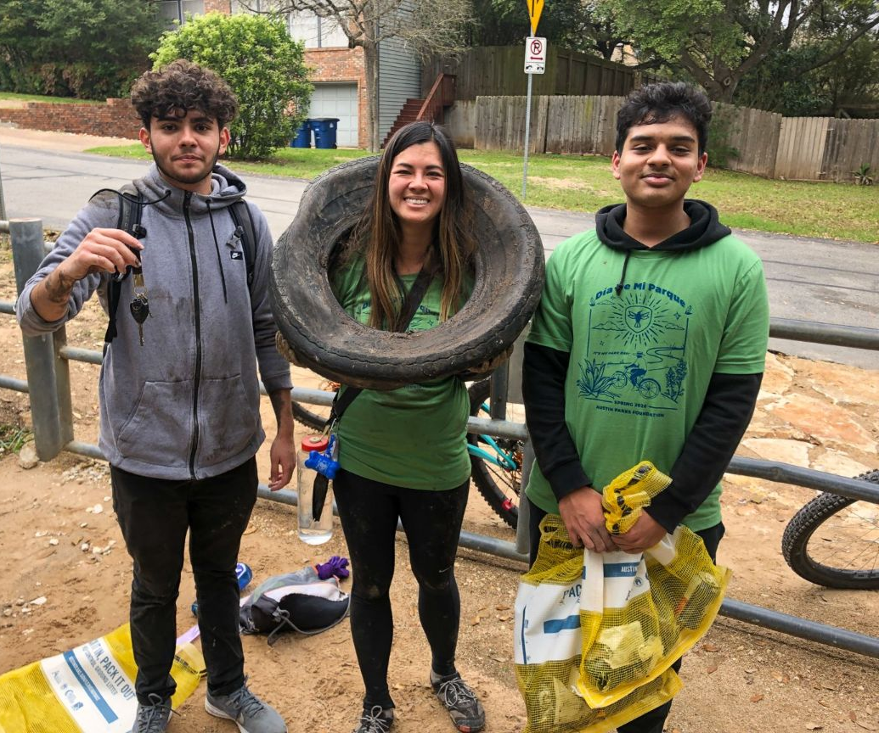
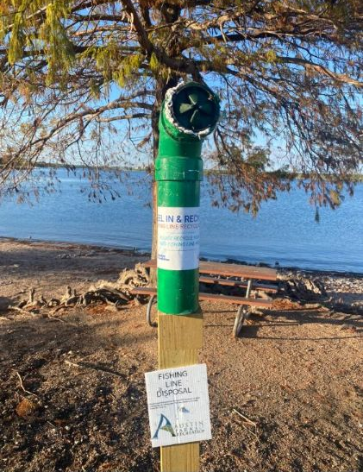
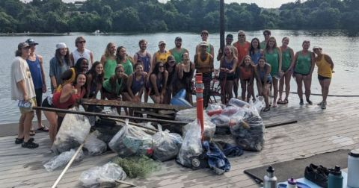
More Litter Solutions
“It’s My Park Day” spring and fall cleanup with partner nonprofit
Waterway/ Creekside litter
  Solution: Reusable yellow mesh bags provided to park campers so they can pack out recyclables to containers at entry stand/pay station area
  Solution: Kayak Clean-Up Crew – park concession provides free kayaks for weekly cleanup event
Monofilament fishing line problem
  Solution: Reel In & Recycle units provided by an Eagle Scout project

Slide 23
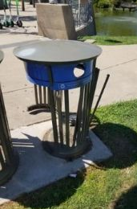
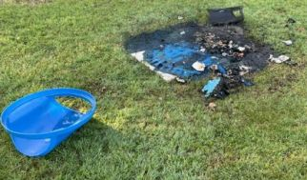
Vandalism
Vandalism of receptacles including burning, graffiti, theft
  Solution: Cable ties for lids, heavy-duty recycled plastic receptacles
  Last resort: Adding old concrete receptacles back

Slide 24
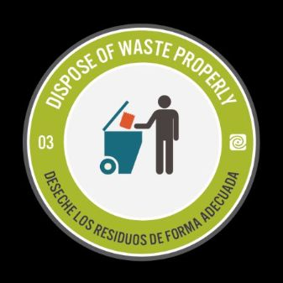

Public Education: Leave No Trace Campaign
Notes:
Barton Creek Greenbelt named as Leave No Trace 2020 Hotspot

Slide 25

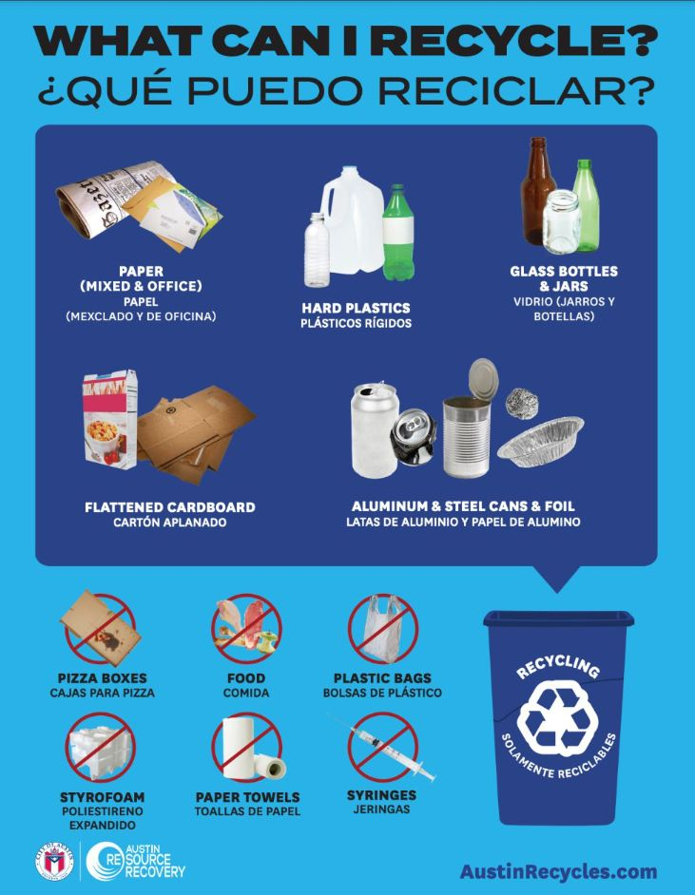


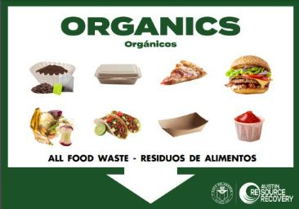
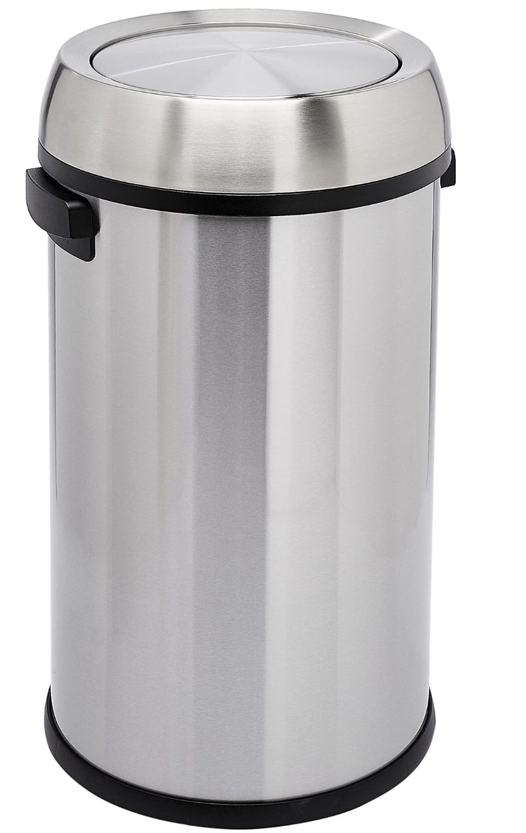

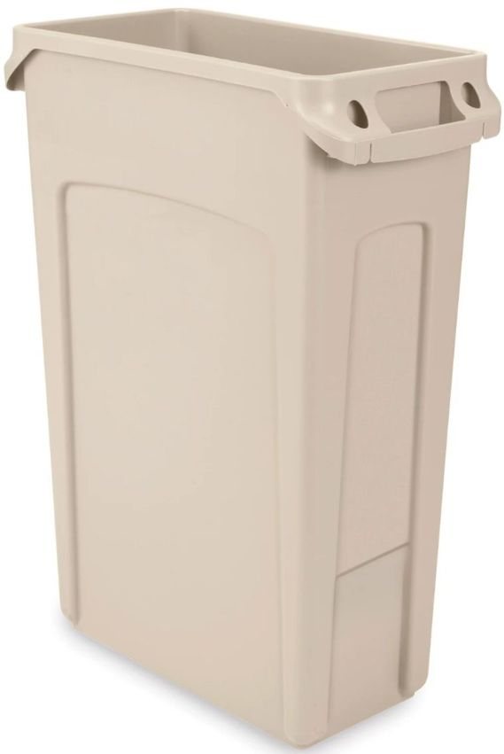
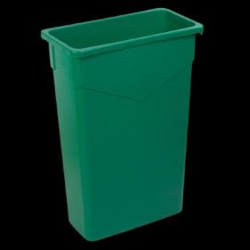
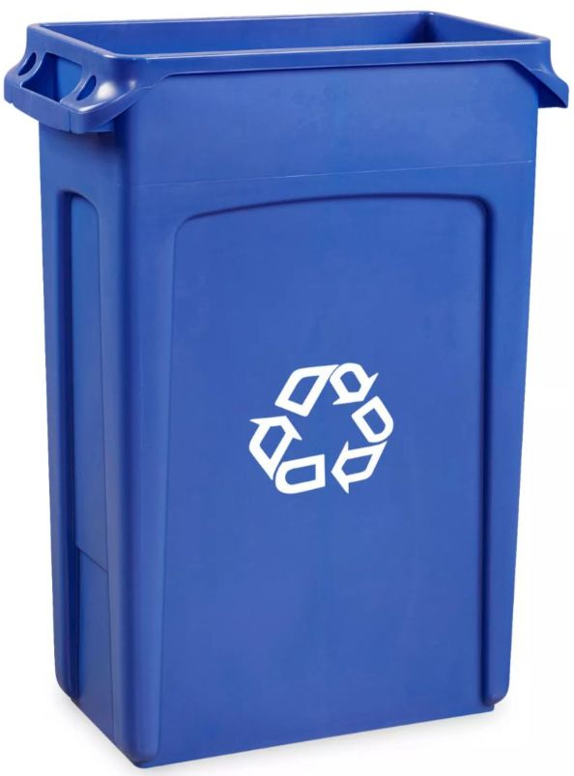



Public Education: Consistent Colors and Labels
LANDFILL TRASH
RECYCLING
COMPOST
Color: brown, grey, black,
silver (with label)
Color: blue or
silver (with label)
Color: green
Notes:
The pictures on this screen show the standard colors for each type of interior container at the city
Brown, grey or black for landfill,
blue for recycling,
and green for compost
In some office buildings where you may only have gray/silver containers for trash and recycling, always be sure to place the proper decal and sign on and around the bin

Slide 26
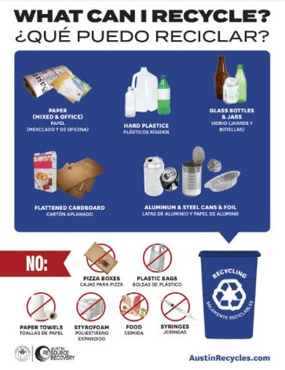
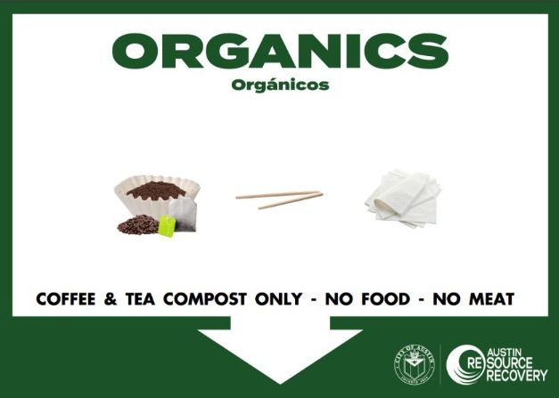
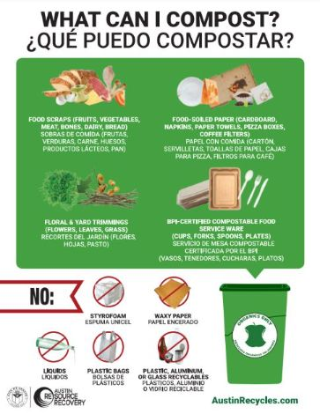


Public Education: Consistent Signage
RECYCLING
COMPOST
LANDFILL TRASH
FREE SIGNS! Use Sign Maker | AustinTexas.gov
Notes:
The pictures on this screen show the standard signage for interior containers at the city
You can download these signs at https://cityspace.austintexas.gov/Policies-Procedures/Zero-Waste-at-City-Facilities

Slide 27
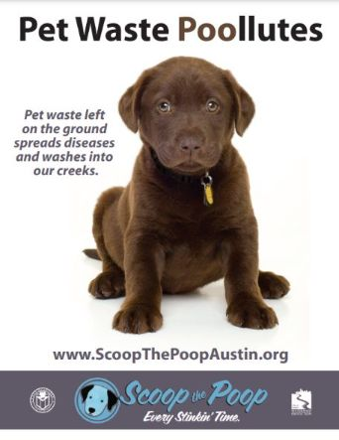
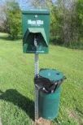

Public Education: Pet Waste
Problem: pet waste thrown into woods, pet waste put in recycling bin
  Solution: “Pet Waste Goes Here!” stickers on trash receptacles (coming soon!)
  Mutt Mitt stations
  Scoop the Poop campaign
Notes:
Barton Creek Greenbelt named as Leave No Trace 2020 Hotspot

Slide 28

Public Education: Recycling Signage
Clear and consistent
“EMPTY CANS & BOTTLES ONLY” to reduce contamination
Notes:
Barton Creek Greenbelt named as Leave No Trace 2020 Hotspot

Slide 29
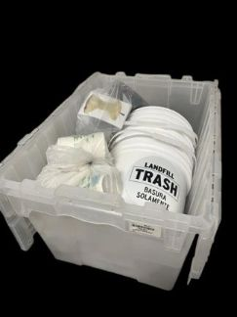
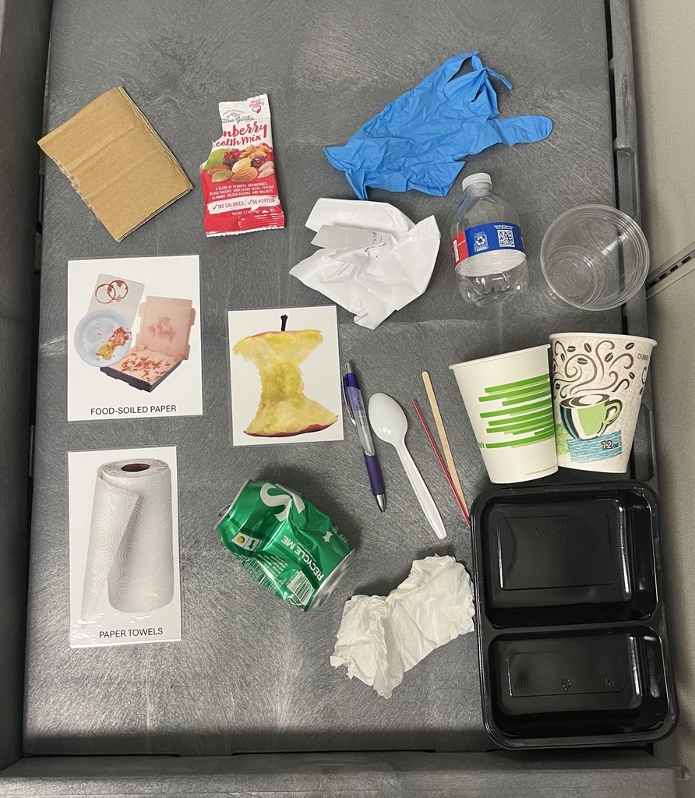
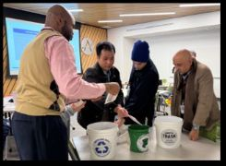
Staff Education: Waste Sorting Kit Game
Waste Items We Used:
2 sets of clean waste items, separated into bags
6 containers with labels
Notes:
Sort 10 items, subtract

Slide 30
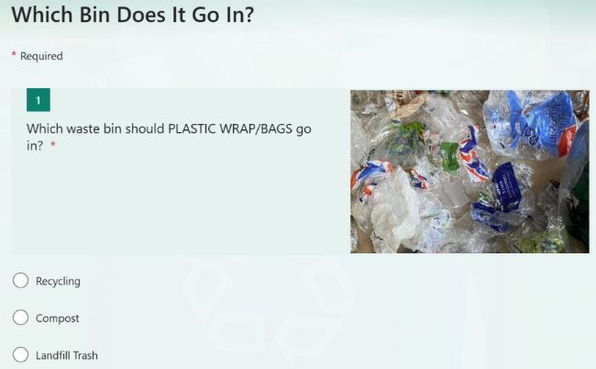
Staff Education: Waste Sorting Quiz
Waste Items We Used:
Notes:
Sort 10 items, subtract

Slide 31
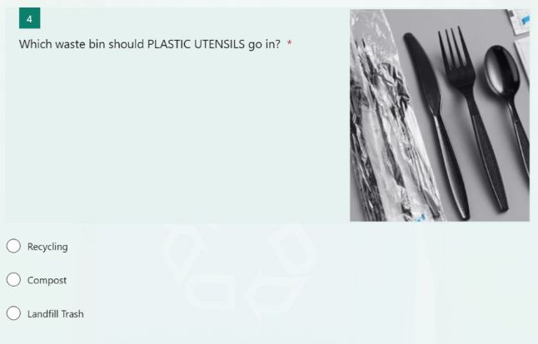
Staff Education: Waste Sorting Quiz
Waste Items We Used:
Notes:
Sort 10 items, subtract

Slide 32
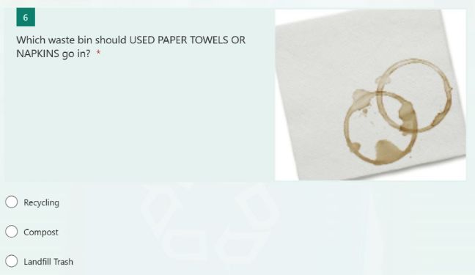
Staff Education: Waste Sorting Quiz
Waste Items We Used:
Notes:
Sort 10 items, subtract

Slide 33

Thank You! Questions?
Meredith Gauthier
meredith.gauthier@austintexas.gov

Slide 34
Live Poll #1
Have you tried removing waste bins to address litter
in a park setting? (Click only one)
Yes, successfully reduced litter
Yes, mixed / inconclusive results
Yes, but caused more litter
It’s worked in some location but not others
No, have not removed bins to address litter
Share details in the chat

Slide 35


Slide 36


Slide 37
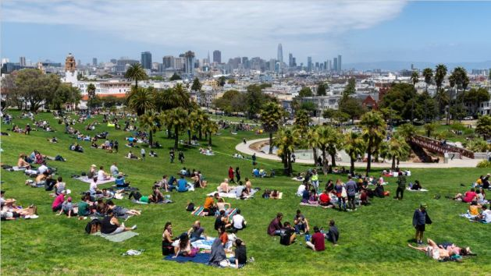

Slide 38


Slide 39


Slide 40


Slide 41


Slide 42


Slide 43


Slide 44


Slide 45


Slide 46


Slide 47


Slide 48


Slide 49


Slide 50


Slide 51


Slide 52


Slide 53


Slide 54


Slide 55


Slide 56


Slide 57

Live Poll #2
Which of the following have you done in your parks? (Click only one)
Onsite signage that speaks to the audience
Leverage surveys as public outreach/education
Use social media to encourage park stewardship
Focus on getting glass out of the park
Share details in the chat

Slide 58


Slide 59


Slide 60


Slide 61


Slide 62


Slide 63


Slide 64



Today’s Program Online Archive of Past Programs
April 2021:
  -City of West Vancouver, BC;
  -Orange County, NC
  -Operation Downtown,
  Des Moines, IA;
February 2022:
  Seattle Parks & Rec / Seattle Public Utilities
  National Mall
  Litter research
+ Other Waste Reduction topics
Recording
Presentation slides
Resources
Link will be emailed in coming days
Visit: https://www.buschsystems.com > Resources > Webinars

Slide 65



Next Up:
Case Study Presentations:
Evelyn Amara Ferreira
San Francisco International Airport
Molly Longton
Arizona State University

Slide 66
Thank You to our Panelists!
Meredith Gauthier
Sustainability & Resilience Program Manager
City of Austin, Parks & Recreation Department
Taylor Emerson
Manager of Strategic Planning
San Francisco Recreation & Parks Department

Slide 67
Please Share Feedback to Presenters
Post-Webinar Survey:
Prompt at end of program, or
Look for Email tomorrow

Slide 68


Stick Around for the Product Demo!
Sarah Hawthorne

